Slide 1
The Biotech Social Contract:
A New Prescription for Innovative and Affordable Medicines
PETER KOLCHINSKY, PhD

Slide 2
THE BIOTECH SOCIAL CONTRACT

Slide 3
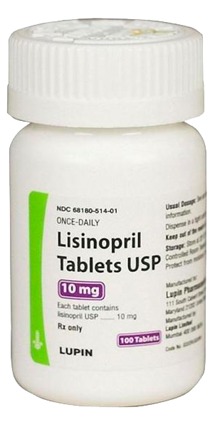
How we celebrate matters
Published 1813
Copyright expired
Can download for free
WHAT'S NOT ON THE LABEL?

Slide 4
How we celebrate matters
WHAT'S NOT ON THE LABEL?
Published 1813
Copyright expired
Can download for free
Invented by Merck (team led by Arthur Patchett) in 1978, launched in 1987 as Prinivil
Generic since 2002.

Slide 5
THE BIOTECH SOCIAL CONTRACT

Slide 6
THE BIOTECH SOCIAL CONTRACT

Slide 7
THE BIOTECH SOCIAL CONTRACT

Slide 8
What is this curve?

Slide 9
COST TO SOCIETY OF Hip replacement surgery

Slide 10
COST TO SOCIETY OF Caring for blindness due to diabetes

Slide 11
COST TO SOCIETY OF Liver transplants

Slide 12
An expense, always growing…

Slide 13
Also: what rent looks like

Slide 14
So what’s this?

Slide 15
COST TO SOCIETY OF A TYPICAL DRUG THAT… Strengthens bones to prevent hip replacement surgery

Slide 16
COST TO SOCIETY OF A TYPICAL DRUG THAT… Prevents diabetic retinopathy (blindness)

Slide 17
COST TO SOCIETY OF A TYPICAL DRUG THAT… Prevents liver cirrhosis due to NASH

Slide 18
Let’s put them together…

Slide 19
LET’S PUT THEM TOGETHER… Projected surgery spending unless we invent a drug

Slide 20
LET’S PUT THEM TOGETHER… We invent a drug

Slide 21
LET’S PUT THEM TOGETHER… Surgery spending drops as surgeries are averted

Slide 22
LET’S PUT THEM TOGETHER… Surgery spending drops but total spending (surgery + drug) climbs

Slide 23
LET’S PUT THEM TOGETHER… Then drug goes generic

Slide 24
LET’S PUT THEM TOGETHER… Then drug goes generic, surgeries are still averted,

Slide 25
LET’S PUT THEM TOGETHER… Then drug goes generic, surgeries are still averted, AND SOCIETY SAVES
Savings accumulate after drug goes generic

Slide 26
Net savings evident in long term… after drug is generic
At society’s 2% cost of capital, society breaks even (in this case) after ~35 years.

Slide 27
THE BIOTECH SOCIAL CONTRACT

Slide 29
IF DRUG DOESN’T GO GENERIC

Slide 30
IF DRUG DOESN’T GO GENERIC Surgeries are still averted

Slide 31
IF DRUG DOESN’T GO GENERIC Surgeries are still averted, but no net savings

Slide 32
Society just pays increasing rent forever

Slide 33
Society just pays increasing rent forever... We shouldn’t be in the rent business

Slide 34
We are in the mortgage business… let’s guarantee that all drugs go generic
At society’s 2% cost of capital, society breaks even (in this case) after ~35 years.

Slide 35
So how can we promise society that all our drugs will become inexpensive after innovation has been rewarded? Agree to simulated genericization in exchange for Insurance Reforms that cap out-of-pocket costs for patients

Slide 36
So how can we promise society that all our drugs will become inexpensive after innovation has been rewarded? Agree to contractual genericization in exchange for Insurance Reforms that cap out-of-pocket costs for patients

Slide 37
So how can we promise society that all our drugs will become inexpensive after innovation has been rewarded? Agree to contractual genericization in exchange for Insurance Reforms that cap out-of-pocket costs for patients.

Slide 38
Congress thinks some drugs are too expensive.
REVENUE

Slide 39
Congress thinks some drugs are too expensive. They acknowledge that drug development is expensive.
REVENUE
INVESTMENT

Slide 40
Congress thinks some drugs are too expensive. They acknowledge that drug development is expensive.
But would just like to cut the biggest drugs down a bit.
REVENUE
INVESTMENT

Slide 41
But that’s not the portfolio we see when we’re first investing in drug development.
REVENUE
INVESTMENT

Slide 42
But that’s not the portfolio we see when we’re first investing in drug development.
I see this.
REVENUE
INVESTMENT

Slide 43
But that’s not the portfolio we see when we’re first investing in drug development.
I see this.
And I have to invest to find out what works and what doesn’t.
REVENUE
INVESTMENT

Slide 44
Big winners
REVENUE
INVESTMENT

Slide 45
Big winners Modest Contributors – still worth developing
REVENUE
INVESTMENT

Slide 46
Big winners Modest Contributors – still worth developing Disappointments – don’t recover development costs
REVENUE
INVESTMENT

Slide 47
Big winners Modest Contributors – still worth developing Disappointments – don’t recover development costs
REVENUE
Failures
INVESTMENT

Slide 48
Big winners Modest Contributors – still worth developing Disappointments – don’t recover development costs
But the whole portfolio was worth funding. Over long run, >15% annual return.
REVENUE
Failures
INVESTMENT

Slide 49
Big winners Modest Contributors – still worth developing Disappointments – don’t recover development costs
But the whole portfolio was worth funding. Over long run, >15% annual return.
Keeps investors happy.
REVENUE
Failures
INVESTMENT

Slide 50
Big winners Modest Contributors – still worth developing Disappointments – don’t recover development costs
But the whole portfolio was worth funding. Over long run, >15% annual return.
Keeps investors happy.
So we are allowed to keep doing it.
REVENUE
Failures
INVESTMENT

Slide 51
Big winners Modest Contributors – still worth developing Disappointments – don’t recover development costs
But the whole portfolio was worth funding. Over long run, >15% annual return.
Keeps investors happy. So we are allowed to keep doing it.
BUT WHAT IF CONGRESS CLIPS THE BIG WINNERS?
REVENUE
Failures
INVESTMENT

Slide 52
Big winners Modest Contributors – still worth developing Disappointments – don’t recover development costs
BUT WHAT IF CONGRESS CLIPS THE BIG WINNERS?
REVENUE
Failures
INVESTMENT

Slide 53
Big winners Modest Contributors – still worth developing Disappointments – don’t recover development costs
Portfolio now not attractive.
~5% annual return?
BUT WHAT IF CONGRESS CLIPS THE BIG WINNERS?
REVENUE
Failures
INVESTMENT

Slide 54
Big winners Modest Contributors – still worth developing Disappointments – don’t recover development costs
Portfolio now not attractive.
~5% annual return?
Investors not happy.
BUT WHAT IF CONGRESS CLIPS THE BIG WINNERS?
REVENUE
Failures
INVESTMENT

Slide 55
Big winners Modest Contributors – still worth developing Disappointments – don’t recover development costs
Portfolio now not attractive.
~5% annual return?
Investors not happy.
They invest elsewhere, and we can’t keep investing in new drugs.
BUT WHAT IF CONGRESS CLIPS THE BIG WINNERS?
REVENUE
Failures
INVESTMENT

Slide 56
Congress suggests that we invest in fewer failures and disappointments.
REVENUE
INVESTMENT

Slide 57
Congress suggests that we invest in fewer failures and disappointments.
That sounds good, right?
REVENUE
INVESTMENT

Slide 58
But which are those?
REVENUE
INVESTMENT

Slide 59
But which are those?
We have to invest to find out.
REVENUE
INVESTMENT

Slide 60
THE BIOTECH SOCIAL CONTRACT

Slide 61
THE BIOTECH SOCIAL CONTRACT

Slide 62
THE BIOTECH SOCIAL CONTRACT

Slide 63
THE BIOTECH SOCIAL CONTRACT

Slide 64
THE BIOTECH SOCIAL CONTRACT

Slide 65
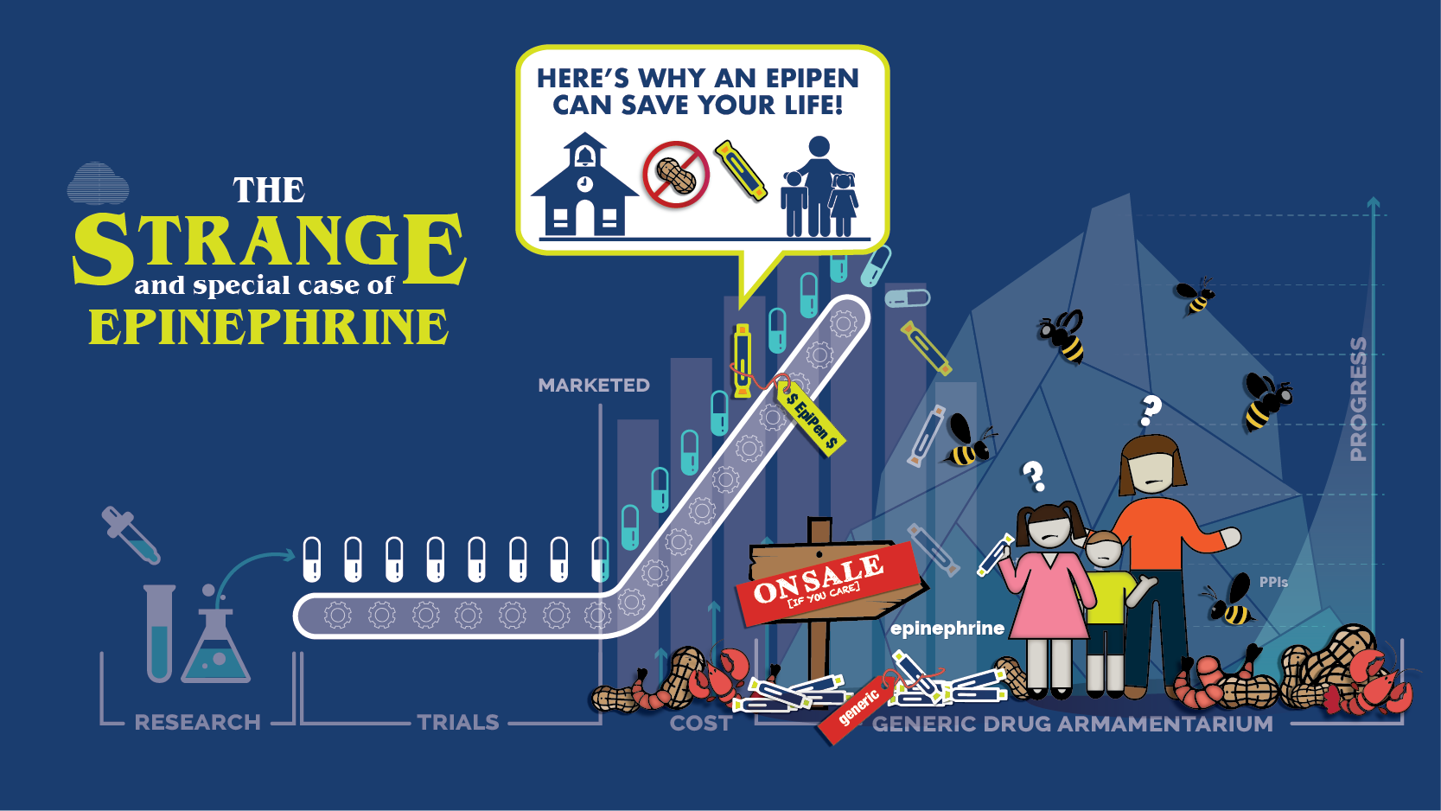
THE BIOTECH SOCIAL CONTRACT

Slide 66
THE BIOTECH SOCIAL CONTRACT

Slide 67
THE BIOTECH SOCIAL CONTRACT

